Slide 1
Sending TCP Data
Session 04
Course : COMP6584001 – Network and Systems Programming
Ivan Sebastian Edbert

Slide 2
Learning Objectives
At the end of this session, the student will be expected to :
Understand the concept of sending and receiving daya
Able to create robust network
Able to solve Common Go TCP Network Problems

Slide 3
Outline
Sending and Receiving Data
Create Robust Network
Solving Common Go TCP Network Problems

Slide 4
Sending and receiving data

Slide 5
Sending and receiving data
Reading data into a fixed buffer
Reading data from a network connection and writing data to it is no dif- ferent from reading and writing to a file object, since net.Conn implements the io.ReadWriteCloser interface used to read and write to files.
TCP connections in Go implement the io.Reader interface, which allows you to read data from the network connection. To read data from a network connection, you need to provide a buffer for the network connection’s Read method to fill.
The Read method will populate the buffer to its capacity if there is enough data in the connection’s receive buffer.
If there are fewer bytes in the receive buffer than the capacity of the buffer you provide, Read will pop- ulate the given buffer with the data and return instead of waiting for more data to arrive.
In other words, Read is not guaranteed to fill your buffer to capacity before it returns. Listing 4-1 demonstrates the process of reading data from a network connection into a byte slice.

Slide 6
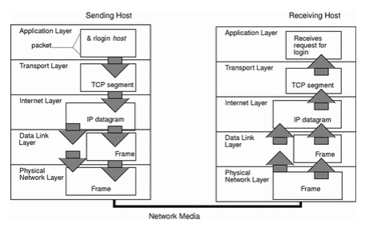
Sending and receiving data
How the TCP/IP Protocols handle data communications

Slide 7
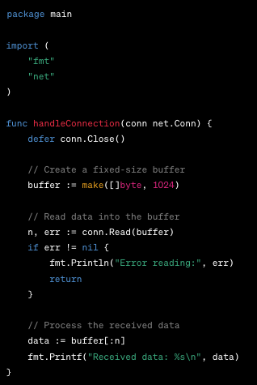
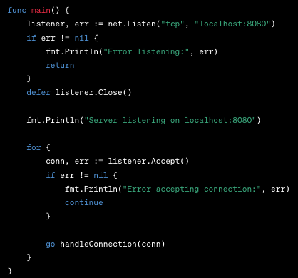
Sending and receiving data
Reading data into a fixed buffer
In this example, the handleConnection function uses a fixed-size buffer of 1024 bytes. The Read method reads data from the connection into this buffer, and the number of bytes read (n) is used to create a slice (data) containing only the received data.
Keep in mind that in a real-world application, you might want to handle errors more gracefully and consider scenarios where the data received is larger than the buffer size. You may need to read data in a loop until you've received all expected data.
Also, note that the actual size of the data received may be less than the size of the buffer, so the data slice is used to capture only the relevant portion of the buffer that contains the received data.

Slide 8
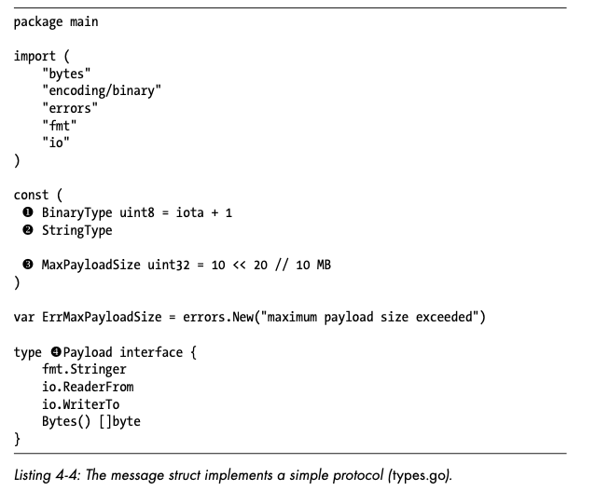
Sending and receiving data
Dynamically allocating the buffer size
You can read data of variable length from a network connection, provided that both the sender and receiver have agreed on a protocol for doing so.
The type-length-value (TLV) encoding scheme is a good option. TLV encoding uses a fixed number of bytes to represent the type o f data, a fixed num- ber of bytes to represent the value size, and a variable number of bytes to represent the value itself. .
Listing 4-4 defines the types that our TLV encoding protocol will accept.

Slide 9
Creating Robust Network

Slide 10


Creating robust network
Golang io package
In addition to interfaces common in Go code, such as io.Reader and io.Writer, the io package provides several useful functions and utilities that make the creation of robust network applications easy.
io.Copy
io.MultiWriter
io.TeeReader
functions to proxy data between connections, log network traffic, and ping hosts when firewalls attempt to keep you from doing so.

Slide 11
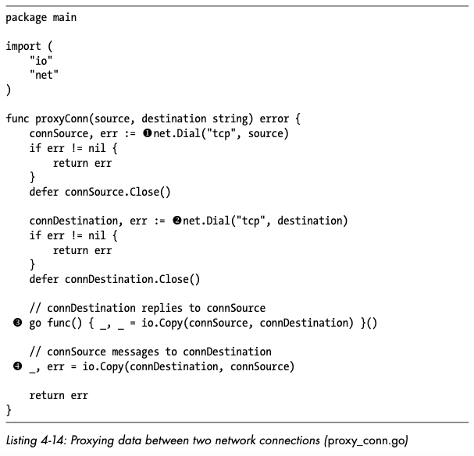
Creating robust network
Proxying data between connections
One of the most useful functions from the io package, the io.Copy function reads data from an io.Reader and writes it to an io.Writer.
This is useful for creating a proxy, which, in this context, is an intermediary that transfers data between two nodes.
Since net.Conn includes both io.Reader and io.Writer interfaces, and io.Copy writes whatever it reads from an io.Reader to an io.Writer, you can easily create a proxy between network connections, such as the one you define in the proxyConn function in Listing 4-14.
This func- tion copies any data sent from the source node to the destination node, and vice versa.

Slide 12
Creating a robust network
Key practices to build a robust network
Planning and Design: Understand the specific requirements of your organization, including the number of users, types of applications, and expected traffic patterns. Design the network with scalability in mind, allowing for future growth in terms of users, devices, and data.
Network Topology: Select a network topology that suits your organization's requirements. Common topologies include star, ring, bus, mesh, and hybrid topologies.
Hardware and Equipment: Invest in high-quality networking hardware and equipment. Consider factors such as reliability, performance, and vendor support & used load balancing to distribute network traffic across multiple server or paths.
Security: Implement firewalls and IPS devices to protect the network, and use encryption for sensitive data, especially when transmitting information over the network. Implement protocols such as SSL/TLS for secure communication.
Monitoring and Management: Use network monitoring tools to track the performance of devices, identify potential issues, and ensure that the network meets its service-level objectives (SLOs). Set up logging and alerting mechanisms to notify administrators of critical events, errors, or security incidents.

Slide 13
Creating a robust network
Key practices to build a robust network
Resilience and Failover: Deploy high-availability solutions to minimize downtime. This may involve redundant hardware, failover mechanisms, and clustering & optimize network protocols and configurations for fast convergence in the event of link and failures.
Documentation: Maintain detailed documentation for network architecture, configurations, and procedures.
Training and Skill Development: Ensure that network administrators and IT staff receive ongoing training to stay updated on the latest technologies and best practices. Encourage staff to obtain relevant certifications, such as Cisco Certified Network Professional (CCNP) or Certified Information Systems Security Professional (CISSP).
Regular Testing and Simulations: Conduct regular testing and simulations to assess the network's resilience under different scenarios, including failures and peak loads. Develop and test disaster recovery plans to ensure a rapid response to major network outages
Vendor and technology Diversity: Avoid reliance on a single vendor or technology to minimize the risk of a single point of failure.

Slide 14
Solving Common Go TCP Network Problems

Slide 15
Go Problems and Solutions
When working with TCP network programming in Go, there are several common issues and challenges that developers may encounter. Here are some solutions to address these common problems:
Handling Errors: Network operations can result in errors, and it's crucial to handle them appropriately.
→ Always check for errors after network operations and handle them gracefully. Use the if err != nil pattern to check for errors and log or handle them according to your application's requirements.
Timeouts: Operations involving network communication can experience timeouts, especially when waiting for a connection, reading, or writing data.
→ Use the context package to set timeouts for network operations. The net package in Go provides a DialContext function that allows you to specify a context with a timeout.

Slide 16
Go Problems and Solutions
Connection Pooling: Establishing a new TCP connection for each request can be inefficient.
Implement connection pooling to reuse existing connections. The sync.Pool package can be useful for managing a pool of connections.
Handling Large Data Streams: Reading or writing large data streams may lead to performance issues or memory exhaustion.
Use buffered readers and writers to efficiently handle large data streams. The bufio package in Go provides BufioReader and BufioWriter types that can improve I/O performance.
Graceful Shutdown: Closing a TCP server abruptly can result in dropped connections and data loss.
→Implement graceful shutdown by using the context package and handling signals. This allows you to close connections and perform cleanup operations before exiting.

Slide 17
Go Problems and Solutions
Connection Handling: Managing multiple incoming connections efficiently..
Use goroutines to handle each incoming connection concurrently. Implement connection limits if needed. Ensure proper resource cleanup after handling each connection.
Packet Serialization/Deserialization: Sending and receiving structured data over the network may require serialization and deserialization.
Use encoding libraries such as encoding/json or encoding/gob for serialization and deserialization. Ensure that both the sender and receiver agree on the data format.
Handling Connection State: Tracking the state of a connection, especially in long-lived connections.
→Use a state machine or connection state variable to manage the lifecycle of a connection. Implement error handling and logging for different states.

Slide 18
references
Adam Woodbeck - Network Programming with Go_ Learn to Code Secure and Reliable Network Services from Scratch-No Starch Press (2021).
https://okanexe.medium.com/the-complete-guide-to-tcp-ip-connections-in-golang-1216dae27b5a

Slide 19
Thankyou

